Slide 1

A Systematic Literature Review on the Effect of Code Smells on Non-Functional Attributes of Source Code PROJECT STATUS-2
Università degli Studi di Salerno
Dipartimento di Informatica
Nazira Munalbayeva
University of Salerno
n.munalbayeva@studenti.unisa.it

Slide 2
Systematic literature review process
1. Identify need for SLR
2. Develop Review Protocol
3. Specify Research Questions
4. Search strategy design
5. Study selection criteria
6. Study quality assessment
7. Data Extraction
8. Data Synthesis
9. Reporting the results
10. Validate Report
Plan review
Conduct review
Document review

Slide 3

Systematic literature review process
1. Identify need for SLR
2. Develop Review Protocol
3. Specify Research Questions
4. Search strategy design
5. Study selection criteria
6. Study quality assessment
7. Data Extraction
8. Data Synthesis
9. Reporting the results
10. Validate Report
Plan review
Conduct review
Document review

Slide 4
Systematic literature review process
1. Identify need for SLR
2. Develop Review Protocol
3. Specify Research Questions
4. Search strategy design
5. Study selection criteria
6. Study quality assessment
7. Data Extraction
8. Data Synthesis
9. Reporting the results
10. Validate Report
Plan review
Conduct review
Document review

Slide 5
Motivation
We are interested about how big is the impact of code smells in a project, for understanding if is really worth to work for individuate and refactor code smells or this operation can be neglected.
During the review of the literature, it was found that there is no systematic review of the influence of the code smells on the NFA of source code. Therefore, we study research using an existing database to reduce research gaps. Goals -Conduct a systematic analysis of academic articles on "The Effect of Code Smells on Non-Functional Attributes of Source Code". -Analyze how code smells impact the NFA of Source Code.
1. Identify need for SLR

Slide 6
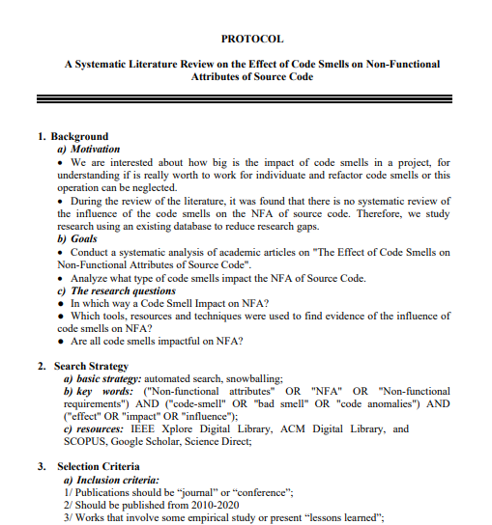
The review protocol that included the following steps: research questions identification, search strategy design, study selection criteria, study quality assessment, data extraction process and data synthesis process.
2. Develop Review Protocol

Slide 7
3. Specify Research Questions
In which way a Code Smell Impact on NFA?
How the connection between code smells and NFA was determined?
Are all code smells impactful on NFA?
We aim to answer the following research questions by conducting a methodological review of existing research.

Slide 8
4. Search strategy design
The following steps were used to construct the search terms:
(a) Derive major terms from the research questions.
(b) Identify alternative spellings and synonyms for major terms.
(c) Check the keywords in relevant papers.
(d) Use the Boolean OR to incorporate alternative spellings and synonyms.
(e) Use the Boolean AND to link the major terms.
The search string below was applied to 4 digital libraries: IEEExplore, Scopus, ACM, Elsevier
Key words:
("Non-functional attributes" OR "NFA" OR "Non-functional requirements") AND ("code-smell" OR "bad smell" OR "code anomalies") AND ("effect" OR "impact" OR "influence") (“Antipatterns” OR “APs” OR “Anti-pattern”)

Slide 9
Inclusion criteria: 1/ Publications should be "journal" or "conference“; 2/ Studies that should answer the research question; 3/ Publications published from 2010 January from now; 4/ Works that involve some empirical study or present "lessons learned“; 5/ If several journal articles report the same study, the most recent article should be included.
5. Study selection criteria
Exclusion criteria:
1/ Studies that do not answer the research question;
2/ Publications published before 2010;
3/ Similar studies i.e. studies by same author in conference as well extended version in journal;
4/ Review studies.

Slide 10
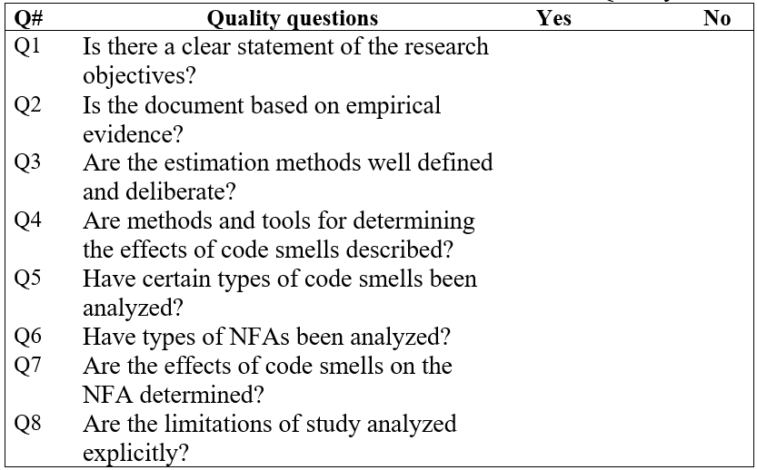
Studies should answer to this questions
6. Study quality assessment

Slide 11
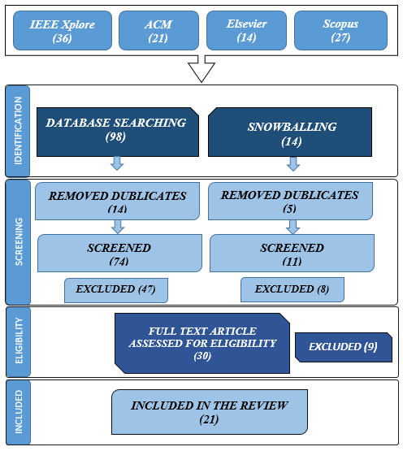
Study selection process

Slide 12
7-8. Data Extraction & Synthesis
The data extraction forms must be designed to collect all the information needed to address the review questions and the study quality criteria.
The goal of data synthesis is to aggregate evidence from the selected studies for answering the research questions.
identification number;
year;
title;
objectives or aims;
code smells;
analysed projects;
research questions and respective answers;
In which way a Code Smell Impact on NFA?
How the connection between code smells and NFA was determined?
Are all code smells impactful on NFA?
software projects or method that illustrate this influence.

Slide 13
References
Kitchenham, B. and Charters, S. (2007) Guidelines for Performing Systematic Literature Reviews in Software Engineering, Technical Report EBSE 2007-001, Keele University and Durham University Joint Report.
Grant Oosterwyk, Irwin Brown and Sharon Geeling (2019), A Synthesis of Literature Review Guidelines from Information Systems Journals, Proceedings of 4th International Conference on the Internet, Cyber Security and Information Systems 2019

